Slide 1

Taming the AWR Tsunami
Roger Cornejo
roger.d.cornejo@gsk.com
Raleigh/Durham, NC
November 6, 2013

Slide 2

Roger Cornejo Speaker Background
Computer Science degree (Rutgers Univ.)
Working with Oracle over 28 years (since V4)
Building/supporting large database applications
1000’s of tuning opportunities
Professional presentations:
Benchmarking
Data Integration
Performance Tuning Bag-of-Tricks

Slide 3


Outline Taming the AWR Tsunami
AWR Introduction
How to Use AWR Data
Tuning Methodology In Practice (examples)
Exploring AWR data (deeper dive)
Advanced topics
Questions
Zip file to be posted
eastcoastoracle.org

Slide 4
AWR Introduction: Can I use AWR?
Licensing requirements
Diagnostics Pack
11g parameter to determine if licensed show parameter control_management_pack_access
10g – tracked externally
Is AWR running on this DB?
10g: Scheduled job: select * from dba_scheduler_jobs where job_name = 'GATHER_STATS_JOB';
11g: 3 standard processes in the auto task window -- Gather stats, segment space advisor and sql tuning advisor. select * from dba_autotask_operation;
;
Note: Could be running, but not licensed => don’t use it if not licensed

Slide 5
AWR Introduction: Why use AWR?
Identify Root Cause of performance problems
Quantify the root cause quickly
AWR Overcomes issues with timing of monitoring
Investigate past performance issues instead of limiting ourselves to present moment monitoring (V$ views)
AWR is Superior to StatsPack
AWR has stats on session
Has other stats not in StatPack

Slide 6
AWR Introduction: What’s in AWR?
Automated Workload Repository
Gathers and persists performance metrics
DBA_HIST Views:
78 in 10g … 111 in 11g
Sessions: SQL, waits, blockers, …
Workload metrics (e.g. IO; Memory; CPU; …)
Object Statistics (e.g. Library Cache; File; Temp; Undo; Latches; Segments; Tablespace; …)
Standard Tools: AWR, ASH, ADDM, … Reports
AWR report consists of dozens of sections; can contain a 100 screens of data or more
How do we make sense of all this information?

Slide 7

How to Use AWR Data: Methodical Tuning Approach

Slide 8
How to Use AWR Data: Methodical Tuning Approach
Identify
What application issue? [Talk to the user] Error? Time? Duration? Instance? User? Module? …
Don’t solve the wrong problem!
Quantify [using AWR tools and data]
Gather information from AWR that applies to ID’d problem
Analyze [your experience along with ADDM Report]
Analyzing SQL by examining: execution plan; table cardinality (size / # rows); waits; …
root cause – known / hypothesized
Tune [Implement Tuning solutions]
Test/Evaluate
Monitor over time using AWR Data

Slide 9

Taming the AWR Tsunami: Case Studies

Slide 10
Case Study 1: Long Running Process Alert e-mail
Identify
Problem: Long Running Process Alert e-mail
Instance: UKPRD662
Connect Username: GWDMPR61
Other: connect time, SQL Id’s, session id’s … reported

Slide 11
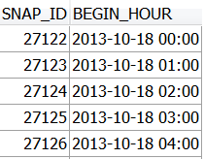
Case Study 1: Long Running Process Alert e-mail
Quantify – get the snap_id’s from AWR dba_hist_snapshot
snap_id from start of the interval
snap_id from the end of the interval
Note and use these snap_id’s: to subset the AWR data in subsequent analysis

Slide 12
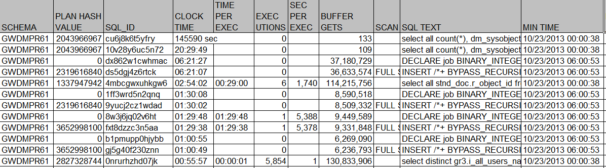
Case Study 1: Long Running Process Alert e-mail
Quantify - SQL
AWR - Expensive SQL for a snap_id.sql

Slide 13
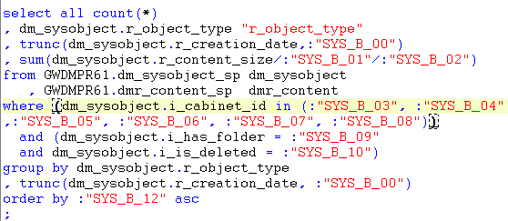
Case Study 1: Long Running Process Alert e-mail
Analyze: Query from DBA_HIST_SQLTEXT

Slide 14
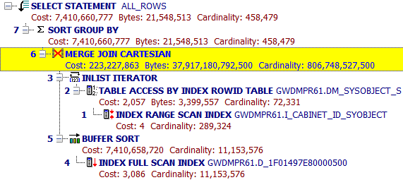
Case Study 1: Long Running Process Alert e-mail
Analyze: Execution Plan from DBA_HIST_SQL_PLAN dbms_xplan.display_awr(‘&SQLID’)

Slide 15
Case Study 1: Long Running Process Alert e-mail
Analyze / Tune

Slide 16
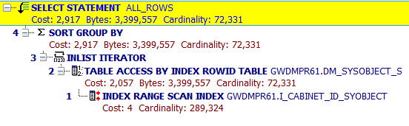
Case Study 1: Long Running Process Alert e-mail
Test/Evaluate
Tuned version ran in 3 ½ minutes

Slide 17
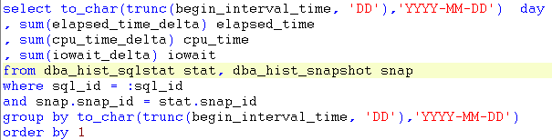
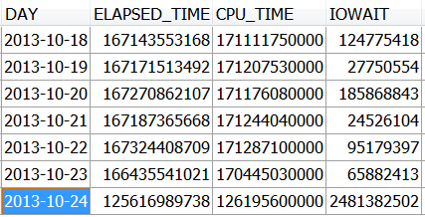
Case Study 1: Long Running Process Alert e-mail
Monitor over time

Slide 18

Taming the AWR Tsunami: Case Studies

Slide 19
Case Study 2: Client Application slow - times out
Identify
Problem:
Client Application slow and times out,
usually with large dataset
Client error:
"Requested operation failed…”
“connection timed out".
Instance: USPRD775
Connect Username: DESIGNER
Time and Interval: “random” / not specific

Slide 20
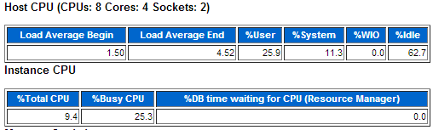
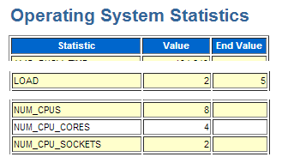
Case Study 2: Client Application slow - times out
Quantify – Load (from standard AWR Report)
Load appears to be low
So let’s look at what SQL is taking the longest time:

Slide 21
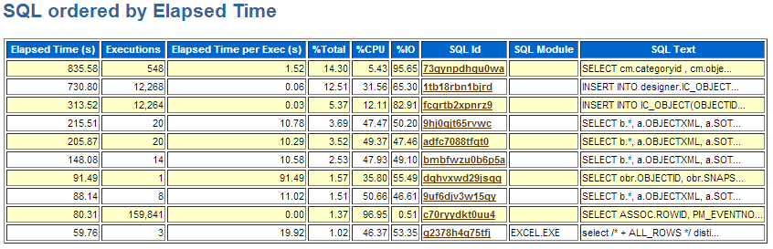
Case Study 2: Client Application slow - times out
Quantify – Slow SQL (from standard AWR Report)
Sql_id: dqhvxwd29jsqg
Time per execution: 92 sec

Slide 22
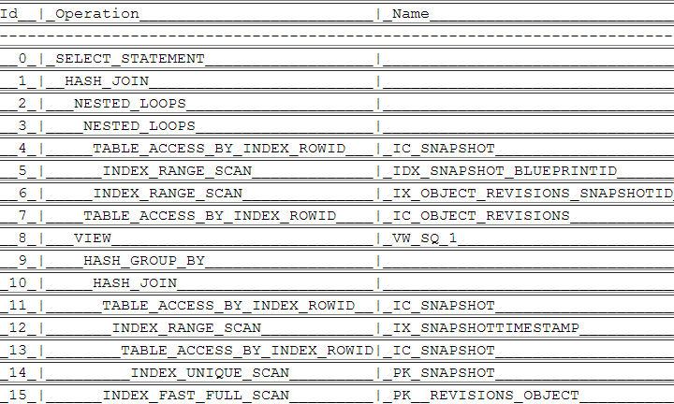
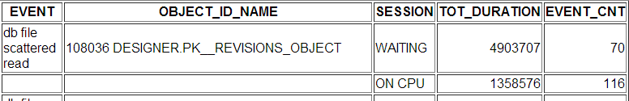
Case Study 2: Client Application slow - times out
Analyze AWR - sqlid profile.sql
Execution Plan: Full scan of index on 10 Gb table
Aggregate Events:
Most waits on
“db file scattered read”
Same index

Slide 23
Case Study 2: Client Application slow - times out
Analyze
Load is low; plenty of capacity on machine/DB
Vendor correlated Slow Sql with the application function
Tune
on vendor to-do list for next version
Test/Evaluate
N/A
Monitor over time
Monitor via DBA_HIST_SQLSTAT

Slide 24

Taming the AWR Tsunami: Case Studies

Slide 25
Case Study 3: Batch Jobs for Sales Force App.
Identify
Problem: Daily job takes several hours to execute; delays other job processing
Interval: runs between 1:30 AM and 5:30 AM (approximately; kicked off by prior job)
Instance: USPRD661
Connect Username: CRM_CH
Code/Module: PrmMy0014Calc.exe; runs from 4 separate sessions simultaneously
Table: Bpldata and others (user does not have SQL)
Basic flow: fetches the data using select queries; performs a calculation; updates the tables with the calculated values.

Slide 26
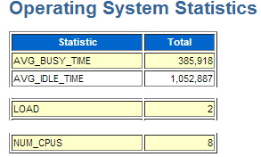
Case Study 3: Batch Jobs for Sales Force App.
Quantify – Load (from standard AWR Report)
Load seems to be ok / low

Slide 27
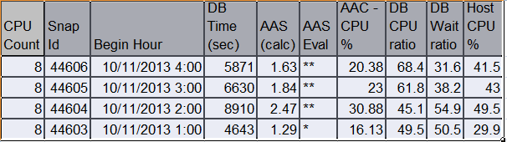
Case Study 3: Batch Jobs for Sales Force App.
Quantify – Load using AAS – Average Active Sessions.sql
This confirms that the load is not a problem.
So now I want to know some more details about the load to see if that can help me focus in on the root cause.

Slide 28
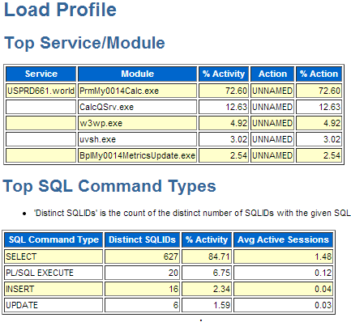
Case Study 3: Batch Jobs for Sales Force App.
Quantify – Load details (from standard ASH Report)
73% db activity this module
85% of db activity is select

Slide 29
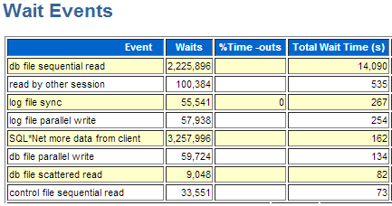
Case Study 3: Batch Jobs for Sales Force App.
Quantify – Waits (from standard AWR Report)

Slide 30
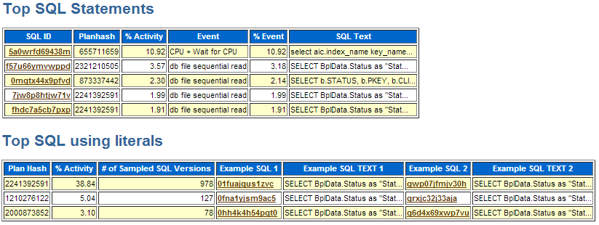
Case Study 3: Batch Jobs for Sales Force App.
Quantify – SQL (from standard ASH report)

Slide 31
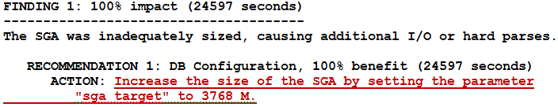
Case Study 3: Batch Jobs for Sales Force App.
Analyze
Load is low (never more that 50%)
Minor log file related waits
App does not make use of bind variables
Big issue is I/O on 14 gig table BPLDATA
Vendor indicated fragmentation and row chaining
High row chaining reads confirmed by looking in dba_hist_sysstat.stat_name = 'table fetch continued row’
Standard ADDM Report: DBA_HIST_SGA_TARGET_ADVICE

Slide 32
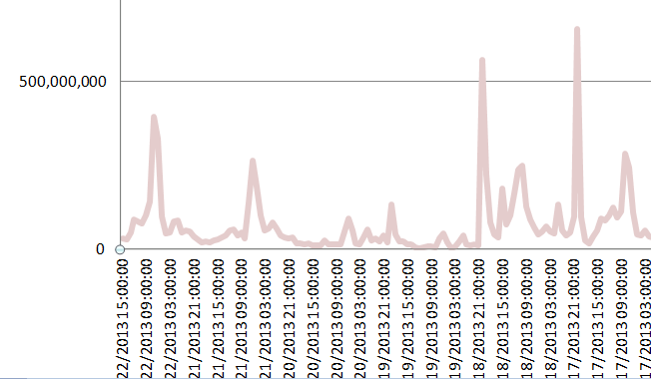
Case Study 3: Batch Jobs for Sales Force App.
Tune
Increase log file size
Re-organize or cluster BPLDATA
Test/Evaluate (in progress w/ application team)
Monitor over time – DBA_HIST_SYSTEM_EVENT
Event: log file synch

Slide 33

Method Recap Taming the AWR Tsunami
1] Identify Problem
2] Quantify using AWR
3] Analysis
4] Tune
5] Test/Evaluate
6] Monitor

Slide 34
Tools Recap Taming the AWR Tsunami
Quantify Load:
Operating System Stats of Standard AWR
Average Active Sessions script
ASH report
Quantify Wait events - standard AWR Report
Quantify SQL
ASH and AWR Report
custom script querying DBA_HIST_SQLSTAT
Custom Quantifying of row chaining reads from DBA_HIST_SYSSTAT ‘table fetch continued row’ statistic
Analysis - ADDM report
Monitor over time with some custom scripts

Slide 35

Exploring AWR Data Taming the AWR Tsunami

Slide 36
Exploring AWR Data: Metrics vs Statistics
Metric
Statistic
Value in that period
e.g.: DBA_HIST_ SYSMETRIC_SUMMARY
Cumulative value
e.g.: DBA_HIST_ SYSTEM_EVENT & SYSSTAT
Use analytic functions:
LAG
compute deltas values
ROW_NUMBER
e.g. Top-n Events script
RATIO_TO_REPORT
% of total

Slide 37
Exploring AWR Data: Comparison of Views
V$ Views | StatsPack Views | AWR Views
V$_SYNONYM_NAME | STATS$_SYNONYM_NAME | DBA_HIST_SYNONYM_NAME
V$SESSION |  | DBA_HIST_ACTIVE_SESS_HISTORY
V$SESSION_EVENT |  | DBA_HIST_ACTIVE_SESS_HISTORY
V$DATAFILE |  | DBA_HIST_DATAFILE
V$DB_CACHE_ADVICE | STATS$DB_CACHE_ADVICE | DBA_HIST_DB_CACHE_ADVICE
V$FILESTAT | STATS$FILESTATXS | DBA_HIST_FILESTATXS
V$LATCH_PARENT | STATS$LATCH_PARENT | DBA_HIST_LATCH_PARENT
V$LIBRARYCACHE | STATS$LIBRARYCACHE | DBA_HIST_LIBRARYCACHE
V$LOG |  | DBA_HIST_LOG
V$OSSTAT | STATS$OSSTAT | DBA_HIST_OSSTAT
V$PARAMETER | STATS$PARAMETER | DBA_HIST_PARAMETER
V$SGA | STATS$SGA | DBA_HIST_SGA
V$SQLSTATS | STATS$SQL_SUMMARY | DBA_HIST_SQLSTAT
V$SQLTEXT | STATS$SQLTEXT | DBA_HIST_SQLTEXT
V$SQL_PLAN | STATS$SQL_PLAN | DBA_HIST_SQL_PLAN
V$SYSMETRIC_SUMMARY |  | DBA_HIST_SYSMETRIC_SUMMARY
V$SYSSTAT | STATS$SYSSTAT | DBA_HIST_SYSSTAT
V$SYS_TIME_MODEL | STATS$SYS_TIME_MODEL | DBA_HIST_SYS_TIME_MODEL
Jumpstart AWR data exploration:
Leverage wealth of knowledge of v$ views

Slide 38
Exploring AWR Data: Key DBA_HIST Views
DBA_HIST_SNAPSHOT
Maps a snap_id to the Date/Time
DBA_HIST_SQLSTAT
Statistics on all SQL statements picked up by the DB
Use this to find the Expensive SQL
DBA_HIST_ACTIVE_SESS_HISTORY
All the sessions and what they were running
Samples rolled up every 10 seconds
DBA_HIST_SYSMETRIC_SUMMARY (135 10g -158 11g)
Various metrics (response time, I/O, …)

Slide 39
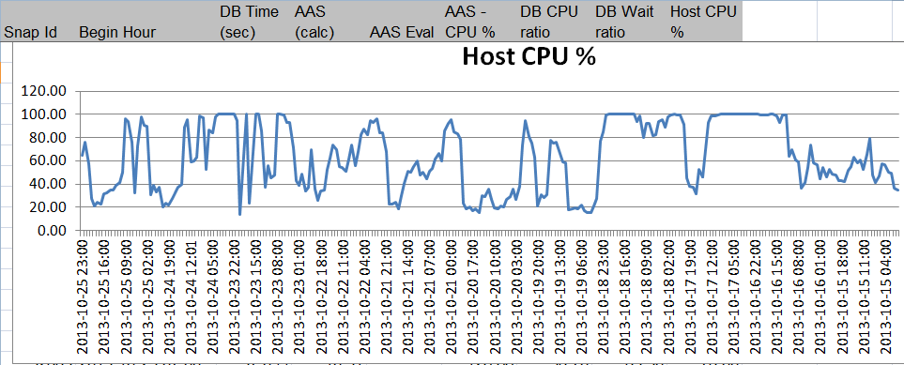
Tracking Measurements Over Time
AAS – Average Active Sessions.sql
Uses: dba_hist_sysmetric_summary.metric_name:
'Average Active Sessions'
'Host CPU Utilization (%) '
'Database CPU Time Ratio'
'Database Wait Time Ratio'

Slide 40
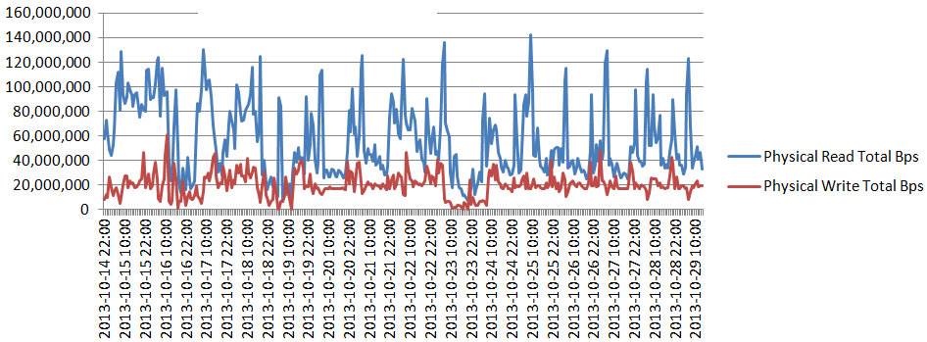
Tracking Measurements Over Time
Load metrics - I/O Workload <query in sql script>
AWR - dba_hist_sysmetric_summary - various metrics.sql
Physical Read Total Bytes Per Sec
Physical Write Total Bytes Per Sec

Slide 41
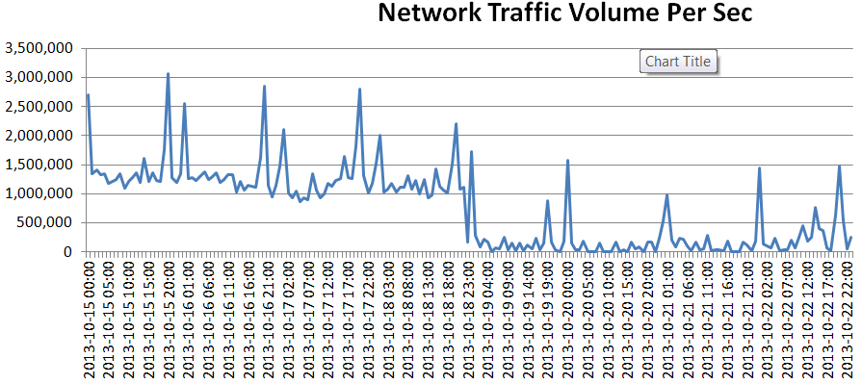
Tracking Measurements Over Time
Load metrics - Workload volume/throughput <query in script>
AWR - dba_hist_sysmetric_summary - various metrics.sql
Network Traffic Volume Per Sec

Slide 42
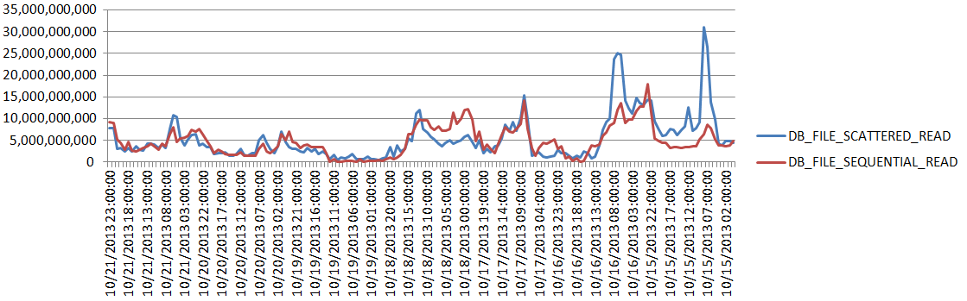
Tracking Measurements Over Time
AWR - Top-n waits by snap_id.SQL
Top-n events – pivoted on Event Name <instructions in code>
Generate code fragments
Edit into “pivot” template
graphing db file scattered read / db file sequential read

Slide 43
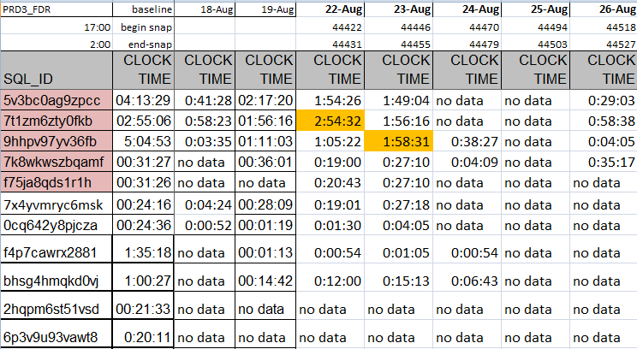
Tracking Measurements Over Time
SQL statistics - AWR - Expensive SQL for a snap_id.sql

Slide 44

Tracking Measurements Over Time

Slide 45

Fun stuff Taming the AWR Tsunami

Slide 46
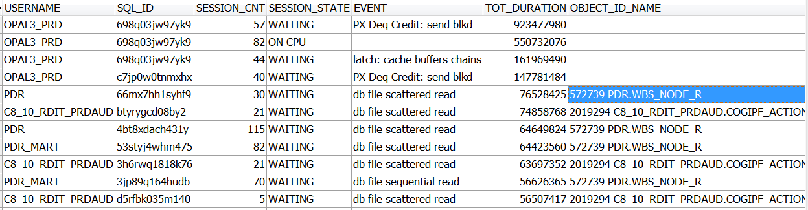
All the SQL associated with an event
ASH – SQL for SnapId - event.sql
Usage Scenario: Have the event name from Top-n waits, but would like to know what SQL is causing that and to what extent
Example execution with: ‘direct path read temp’

Slide 47
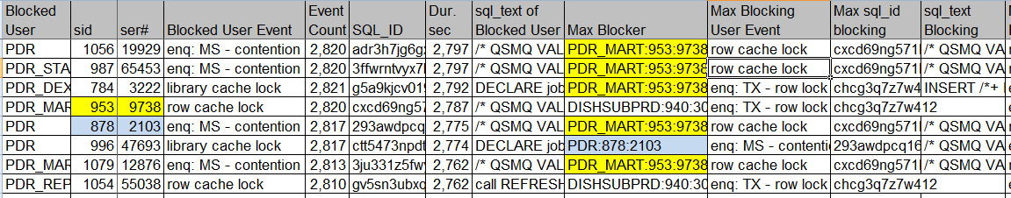
Sessions that were Blocked by other Sessions
ASH - Blocked Sessions.sql
Usage Scenario: App slow, but SQL seemed tuned. Found blocker and related info: Duration; sql_text of Blocked User; Blocker sid/event/sql_id; sql_text …

Slide 48
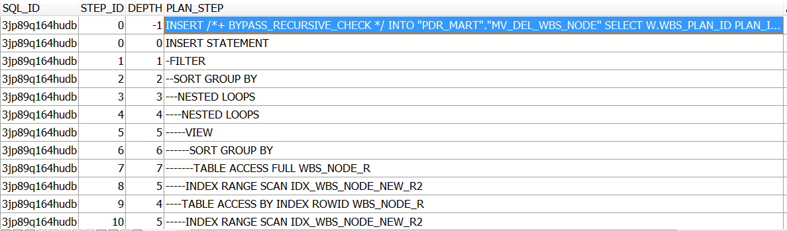
Get all the SQL that involve a particular Object
AWR - sql and plan for an object.sql
Usage Scenario: High I/O on a particular table or index … What other SQL hits that same object?

Slide 49
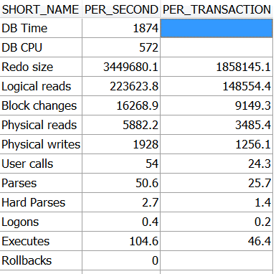
Reverse Engineering an AWR Report
AWR - Report Queries.sql
Usage Scenario: Data for Load Profile Section of AWR Report

Slide 50
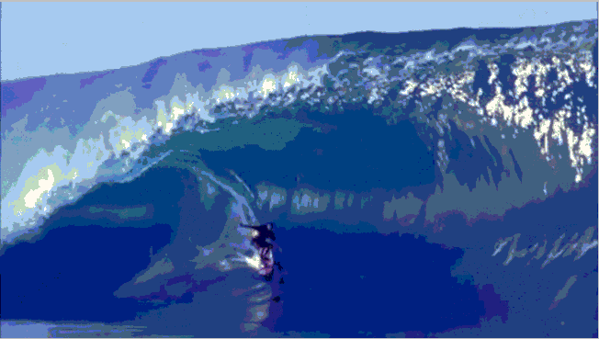
Taming the AWR Tsunami
Roger Cornejo roger.d.cornejo@gsk.com

